Slide 1
How Things Work: Linux
Building Linux
@khenidak

Slide 2

Where we are. Where we are going. https://aka.ms/k8s/howthingswork https://github.com/khenidak/on-linux
you are here
Processes + IPC
FS + Block Dev
I/O
Networking 1
Networking 2
Containers
Building Linux
Extending Linux

Slide 3
Why are Here Today
Linux has many form factors. It can run on SOC and large high-end servers.
The difference between them is not code but which components/features/flags composing the OS.
Running and operating Linux at a scale is a function of how many of these components and feature work together with external systems.
Extending Linux requires understanding the many components that Linux is composed of.

Slide 4
Topics
Boot Sequence (What Makes Linux.. Linux).
Building Linux, Building Images
Running a Virtualized Environment
Intro Fleet Style Operations

Slide 5
Linux Boot Sequence

Slide 6
At a High Level
BIOS
Bootloader
Kernel
Init

Slide 7
BIOS
BIOS is the void main() of your computer. It performs four important functions:
H/W configuration (e.g., enable this/disable that) or boot device selection (more later on this).
System internal H/W self tests.
System integrity checks (UEFI secure boots).
Starting the bootloader (commonly referred to as BIOS POST): BIOS looks at the first sector (512b, only 446 bytes used and last two bytes must have mark identifying usable bootloader) for bootloader and handover control there. (note the implicit assumption that storage device is partitioned, specifically a MBR style partition).
BIOS v UEFI
BIOS was developed 1982 by intel. It runs in 16b mode (turns the CPU in real-mode).
With the advent of root-kits attacks it has become clear that we need a more secure approach. Intel started EFI before Microsoft and other partys joined in defining UEFI (e.g. the entire UEFI load sequence).
UEFI (still called BIOS ¯\_(ツ)_/¯) runs in 64b mode, uses more memory and can optionally do GUI. Because it understand file system it can have configuration on the main storage device of the system “/efi” accessible even after UEFI exists.
MBR v GPT
MBR is old partition scheme didn’t support larger disks. GPT uses GUIDs for partitions supports larger disks (we are unlikely to break the limits anytime soon). With BIOS the storage device must be MBR. Hence for older systems you can use GPT iif the first partition is 512b (with guid 21686148-6449-6E6F-744E-656564454649). Your petitioning tool knows how to do this.

Slide 8
Network Boot
BIOS can select network device as boot device. The sequence goes as:
Network device looks for DHCP server that configure network device + PXE config.
PXE image typically downloads bootloader + kernel images from remote server via TFTP
OR PXE client (network card) chain another PXE image configured (e.g., IPXE) configured to connect to iscsi LUN to begin the boot.
PXE v IPXE:
PXE is old standard, IPXE started by google under a different name. The key differences are:
IPXE can work with http servers in addition to TFTP
IPXE supports iscsi
IPXE supports chaining of pxe images e.g.: “pxe loads ipxe” (so you wouldn’t have to flush each network card with a new image)

Slide 9
At a High Level
Local bootloader
Direct attached
1st Stage Read config Self tests
2nd Stage load bootloader
pxe
Kernel
Init
BIOS
remote bootloader

Slide 10
Bootloader
Perform multi-OS or multi kernel-image boot.
Understands file systems and partitions and thus can load OSs from specific partitions according to its configuration.
LILO v GRUB v GRUB2.
LILO was Linux specific bootloader before being replaced by GRUB->GRUB2. GRUB2 is current SOP (even when systemd-boot exists).
GRUB2 can load windows, BSD and Linux.
In all cases:
Bootloader loads the kernel and its init ram disk (initrd).
Bootloader runs the kernel image passing in kernel image arguments.

Slide 11
At a High Level
1st Stage Read config Self tests
2nd Stage load bootloader
Read config
Splash screen
Select kernel
Load kernel
Load initrd
Pass args
Kernel
Init
BIOS
Bootloader

Slide 12
Kernel + initrd
Kernel is an optionally compressed image. Kernel internal load sequence is complex and way beyond the scope of current discussion. But if you really want to know the details check this series: https://0xax.gitbooks.io/linux-insides/content/Booting/
initrd is an image referred to as “initial root/boot filesystem” that is available before the actual root file system (also referred to as 1st stage boot). Initrd is used to load additional module, any specific configuration and mounting the root file system.
It is also the debug console if 1+ stage boot fails.
A boot sequence can end with initrd (e.g., embedded system or custom shape systems).

Slide 13
Init
Kernel boot sequence ends by calling init proc (i.e., PID:1). When this process exists, the system is shutting down (or crashing if ended incorrectly). It is the only process where kernel will not send a signal to if it does not have a registered handler (hence init does not respond to sigkill).
Init is the root process and is responsible for:
Configuring the system (e.g., detecting and configuring network or various cgroups config)
Starting and supervising various services (e.g., sshd).
Mounting other filesystems and block devices. Specially those that require userspace assisting processes daemons (e.g., fuse || NBD).
The entire init can be replaced with a single application (e.g., the case of virtualized containers).

Slide 14
At a High Level
1st Stage Read config Self tests
2nd Stage load bootloader
Kernel boot + initrd then init call.
Configure system
Start and supervise processes
Mount other file systems
Read config
Splash screen
Select kernel
Load kernel
Load initrd
Pass args
Kernel
Init
BIOS
Bootloader

Slide 15
Putting it together: An Example
System is composed of the following:
A diskless server with a NIC capable of either pxe or ipxe.
Remote storage (specifically iscsi) with a LUN that has kernel, initrd, root filesystem.
Configuration
dhcp configured to provide ip and PXE configuration (configuration depends on what DHCP server you use, but typically you point to TFTP server as next server + regular IP/lease settings)
TFTP server offers ipxe image
ipxe image that boots logins to iscsi target and loads kernel and initrd
#!ipxe
# configure net
dhcp set initiator-iqn iqn.2007-08.com.example.client:client
# hook san (you can also point to efi file here)
sanhook --drive 0x80 iscsi:<MATCH TARGET IP>:::<TARGET LUN NUM>:iqn.2016-09.com.gotgt.gostor:example_tgt_0
# start boot
sanboot --no-describe --drive 0x80
Make sure that initrd loads the correct kernel modules needed to connect to “root drive”
Make sure that kernel knows where it is via kernel boot arguments in grub config (which are then passed to modules).
GRUB_CMDLINE_LINUX_DEFAULT=””
GRUB_CMDLINE_LINUX_DEFAULT=”ISCSI_INITIATOR=<any name> ISCSI_TARGET_NAME=<TARGET NAME MATCH CONFIG>” ISCSI_TARGET_IP=<TARGET IP> ISCSI_TARGET_PORT=<TARGET PORT> root=UUID=<LUN UUID> ip=dhcp <.. other console tty settings>”

Slide 16
Init: Systemd
A quick round around systemd

Slide 17
Systemd
Systemd replaced existing init systems on most distros by 2015 notably RH was the first to use it widely.
Calling Systemd an init system is a misnomer (and that is why it attracts a lot of criticism. For more watch this). It is:
An init system duh.
Service supervisor (dependency graph, startup sequence, restart operation).
Configure resource governance via slices (based on cgroups).
Network manager.
DNS manager.
Device manager.
Programable api surface (via systemd dbus).
Session manager
Boot loader.
System logging.
…
You don’t have to use the entirety of systemd. You don’t even need an init system (well unless you want a multi app box).

Slide 18
Systemd as an init+supervisor
Like everything Linux systemd uses files for configuration. Once files are created they are loaded into systemd via systemctl daemon-reload followed by systemctl enable/start <unit-name>
Systemd is organized as configurable set of “targets” similar to SysV run-levels. Units belongs to targets IOW as part of reaching this target this unit must start (more here).
A unit file is a bunch of directives grouped into a categories. Directive defines what to start, the dependencies, the slice .. e.g.,
[Unit]
Description=service_description
After=network.target
[Service]
Slice= slice_name
ExecStart=path_to_executable
Type=forking
PIDFile=path_to_pidfile
[Install]
WantedBy=default.target

Slide 19
Userspace Components
In addition to init system userspace typically needs a package system
Current leading standards are:
RPM packages offered by RHEL (RHEL, centos, Fedora) like distros.
DEB packages offered by Debian (ubuntu, Debian, mint) like distros.
They operate in a similar way:
Server side offers packages + their metadata (specifically dependencies) in an agreed upon format. Packages are a collection of binaries and install scripts (called on state machine triggers). Packages offer checksum for client-side to verify correctness of download.
Package indexes + their metadata
Mirrors, Mirrors .. LOTS OF MIRRORS!
Client-side executable that can download, verify, install, uninstall, purge etc packages.
Some intelligence on client side. E.g., auto-update or similar controls. In addition to “add a syndication endpoint (e.g., private package repo).
Some innovation (e.g., NixOS) in package management focused on reproducibility.
When do you not need a package system:
Some distros (e.g., CoreOS) let go of the entire thing all together and update via shadow partitions. Where the entire OS is downloaded to a secondary partition then said partition is used for next boot while using the existing primary partition as “last known config”. Noticeably this was first spearheaded by android. The package system syndicates the OS not packages.
Single app OS (no init and no package systems needed).

Slide 20
Building Linux Images

Slide 21
Three Build Options
Manual. The entire can be manually done (I advise going through it once for learning):
Create disk image, then mount it locally, then partition it.
Copy your bootloader, kernel images, userspace components along with all the configuration files.
By a distro specific tool-chain:
Debian offers debootstrap which automate the above steps on a chroot environment.
Fedora like systems offer “image builder” tool chain.
By a tool-chain:
Hashicorp packer offers a configuration driven build pipelines to produce various images.
What will work for me?
If you are always producing the same distro-based images, then using distro specific tool chain.
If you are producing the same image (e.g., same app) but different distro then try looking into packer.
If you are doing something super funky (don’t, unless you you have the needed deep understanding) then use manual approach. It is easier to add on a custom baseline tool than trimming out of existing tools.
YMMV ¯\_(ツ)_/¯
Wait, is this the same for container images?
No, container images follow their build logic and tool-chain.

Slide 22
Building The Kernel

Slide 23
Understand The Source Trees
Choosing the source/tree depends on what you are trying to test/build on:
Versioned drops are here: https://cdn.kernel.org/pub/linux/kernel/v5.x/linux-<version>.tar.xz
Mainline (all versions) DO-SHALLOW-CLONE! git://git.kernel.org/pub/scm/linux/kernel/git/torvalds/linux.git kernel versions are tags on this source tree.
net-next: net next tree is where most of networking vNext (e.g., BPF goodies) lives ~/netdev/net-next.git
Linux-next: a tree holds the patches readied for next merge windows ~/next/linux-next.git
Some working groups use specific trees such as netfilters (~/netfilter/nf.git)
Distros offer their sources via different means (typically OS packages). But their source trees are published on git repos (e.g. git://kernel.ubuntu.com/ubuntu/ for ubuntu). More specialized kernel versions such as azure’s ubuntu (https://code.launchpad.net/ubuntu/+source/linux-azure) exist in their respective repos.
Do I need to build the kernel if I am just trying to build a module? No. You can use “headers” (typically offered as a stand-alone package) to create and build kernel modules.
Note: it is always a good idea to verify the hash or the checksum of whatever you downloaded.

Slide 24
Kernel Build Options
Kernel source code is heavy on #ifdef usage. Those directive are controlled by configuration file (key value pairs separated by `=` on each line). Most options are y|| n || m values where m means “build it as a stand alone module”.
Creating the configuration:
The fastest way: make tinyconfig produces the smallest functional configuration.
The default way: make defconfig produces a balanced kernel with a good selection of configuration.
Just like the past: copy an existing configuration from your kernel (typically at /boot) and reuse it. You can also use make oldconfig for that.
Full Control: make menuconfig starts an ncurses based UX where you can walk through all the options (with their documentation) the interface also allows for simple option search.
Best Way? You are typically working with a couple or more options. Select a good configuration that you are familiar with as a baseline option then modify these options as needed. Again, YMMV.

Slide 25
Kernel Build
Building the kernel is as simple as make build –j n O=<out-of-tree drop> (assuming you have installed the pre-reqs).
Build produces three files:
Symbol Table: system.map-<version> file
Compressed kernel image: vmlinuz-<version>
Compressed Initramfs file: initramfs-<version>
You can directly install on local (install modules, install kernel, update grub, update initramfs).
To understand more about image types read this

Slide 26
Doing Damage!
Initrd (block-based file) or initramfs (compressed file system) both run before init systems. You can do plenty of interesting things here for “fun”. You will typically need to modify initrd if your FS needs a driver that is not part of the kernel (e.g., needs loading).
To decompress the file: cat <initram fs file>| cpio –id
To compress the file: find . | cpio -o -H newc | gzip -9 > <init ram fs>
The file of interest is a shell script here: /init

Slide 27
Virtualization: 101 (KVM)

Slide 28
It looks like magic. Almost is. But it is not.
KVM is a kernel module (since v2.6) that offers a device file /dev/kvm where ioctl can be used to start/stop VMs. VMs start as a process w/ threads (each vCPU is a thread on the host system). Threads run on CPU in virtual mode (i.e., VT-x, VMx etc extensions). VMM (e.g., QEMU) controls the VM state machine via ioctl() calls to KVM device file.
Threads execute in the protected mode until they need to interact with H/W where they perform exit instruction vmexit() to execute on the host. CPU state for VM and host are saved/restore in the process.
From a H/W standpoint there are four ways to offer h/w to VM:
Emulated via the likes of QEMU (KVM and QEMU share a memory mapped file).
Passthrough (sometimes called dedicated) the device is exclusively offered to the VM.
SRIOV where a PCIe device is split into 1 Physical Function (root) and N Virtual Functions (one or more per VM).
VIRT-IO (para virtualization) where a ring buffer is placed between an in-vm FE driver with a BE driver running on the host (either as a userspace driver or a kernel space vhost ¯\_(ツ)_/¯ driver).
What about libvirt? libvert is an UX, cli, api, tool-chain, daemon that helps running virtual systems.
You don’t have to go all or none. You can compose your environment any way that fits your requirements.

Slide 29
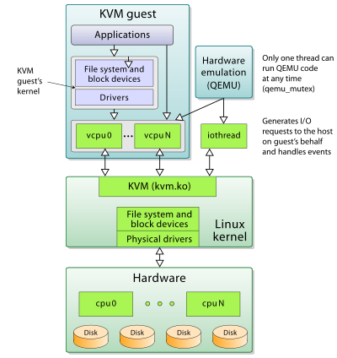
How does it look like?

Slide 30
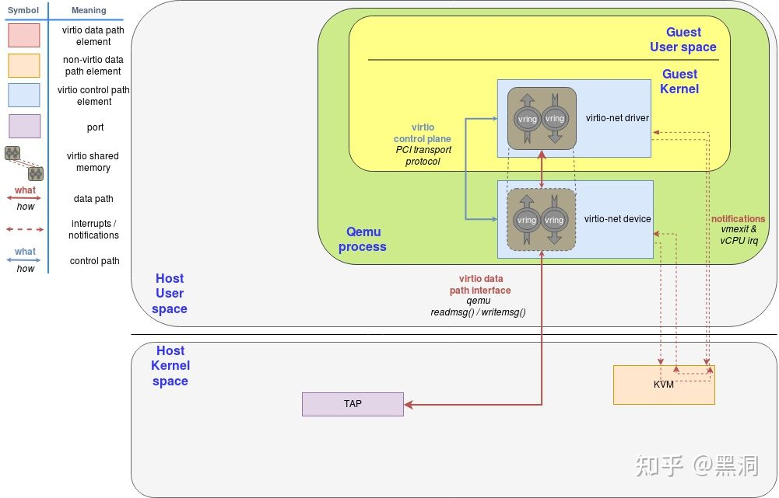
How does it look like?

Slide 31
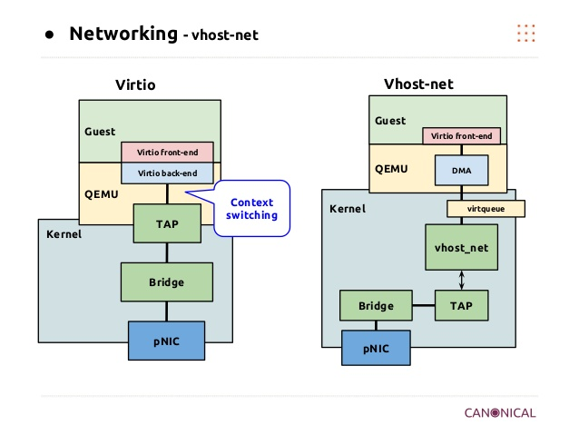
How does it look like?

Slide 32
Thank You

